Slide 1
Structured Data Extraction through Wrapper Generation
Web and Social Network Analytics Practical - 08

Slide 2
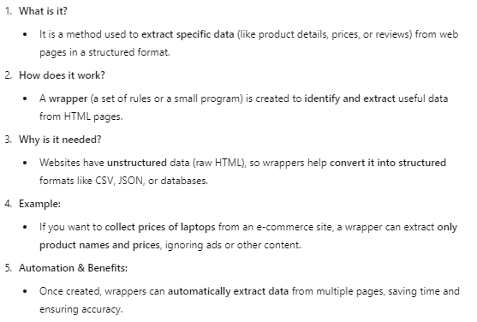
Structured Data Extraction through Wrapper Generation.

Slide 3
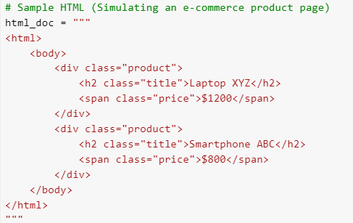
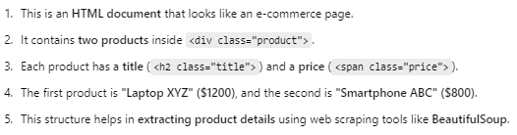

Slide 4


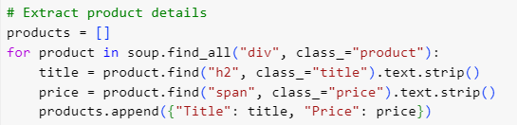
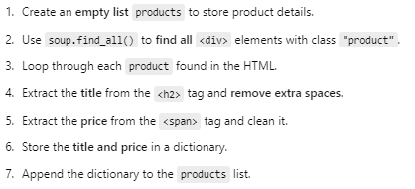

Slide 5





